Slide 2




WPC055 – Visual Studio App Center Deep Dive
RICCARDO CAPPELLO
@rcappello
rcappello@outlook.com
Operative manager @alten italia Microsoft Azure MVP Intel Software Innovator

Slide 3

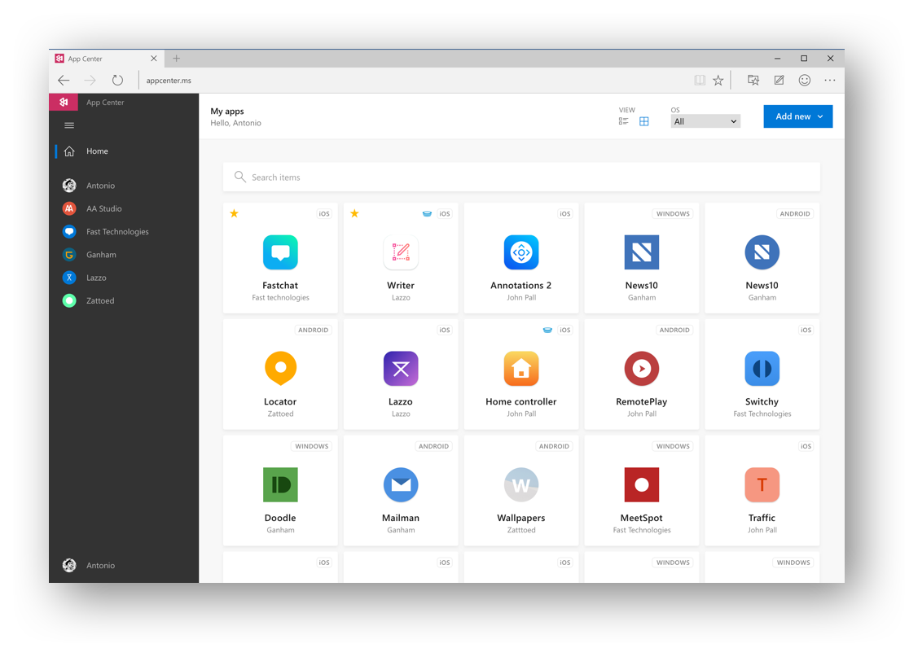






Visual Studio
App Center
appcenter.ms
Notes:
R

Slide 4
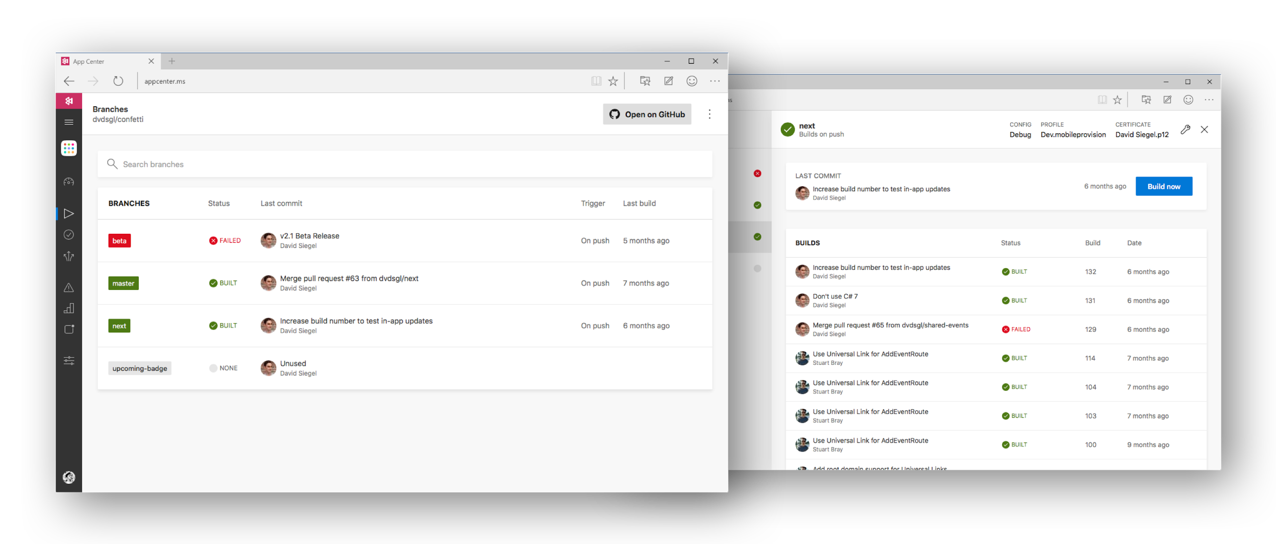


Visual Studio App Center
Notes:
R

Slide 5
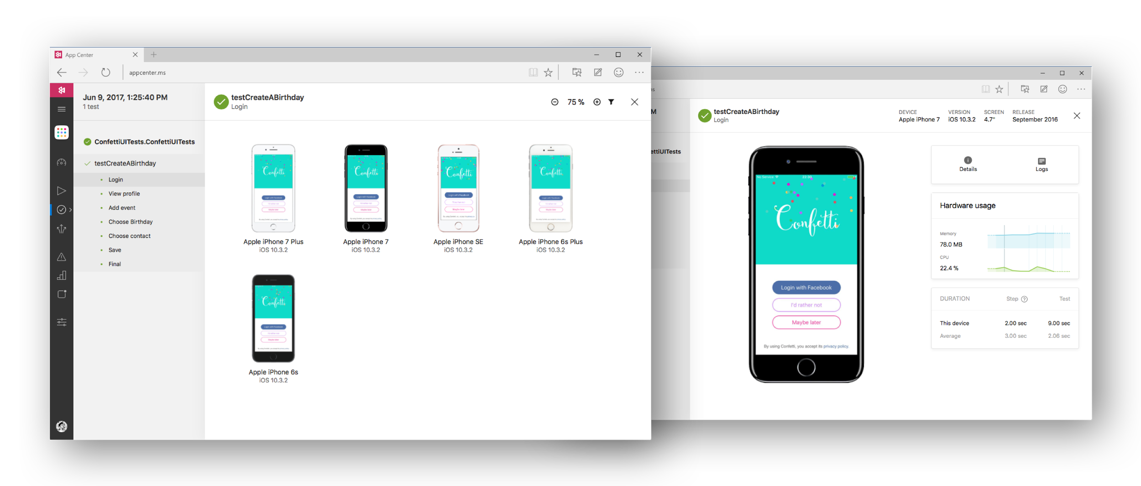

Visual Studio App Center
Notes:
R

Slide 6
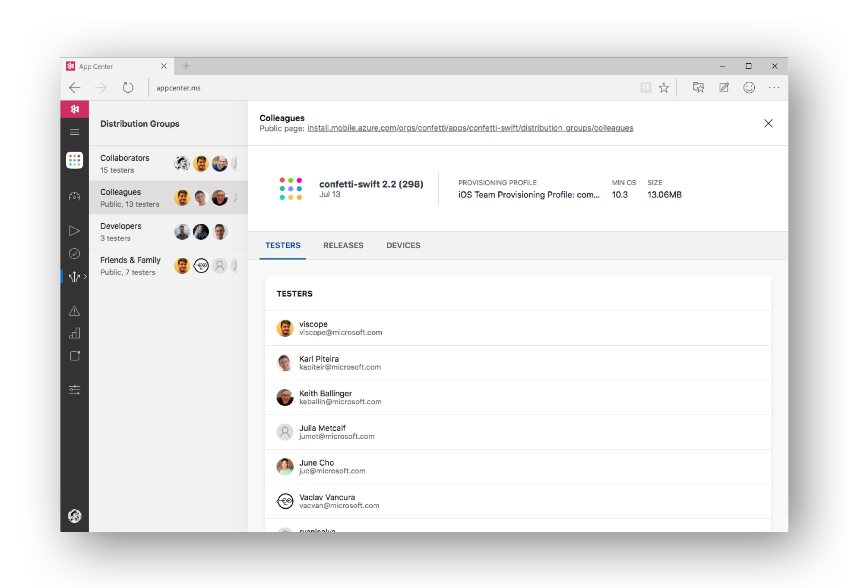

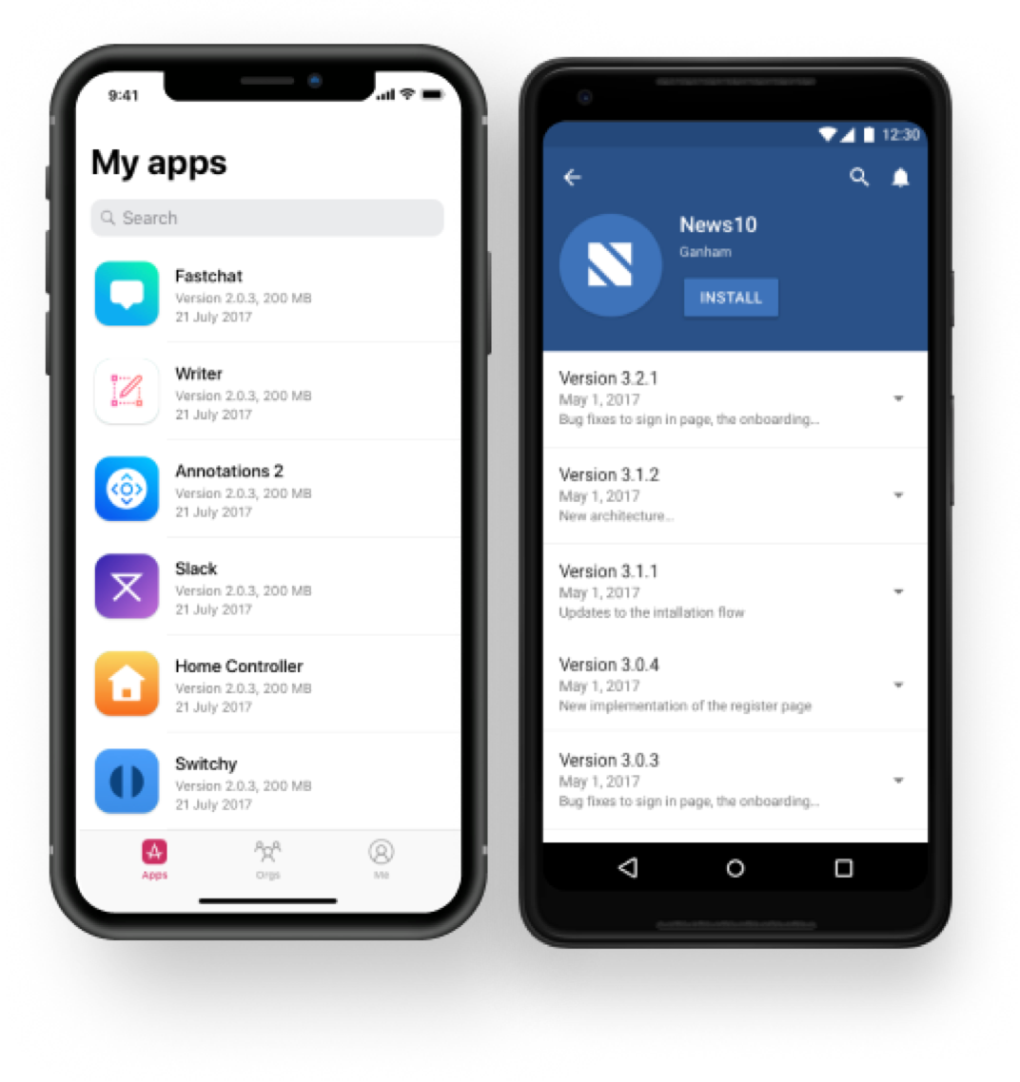

Visual Studio App Center
HockeyApp
iOS, Android, UWP
Notes:
R

Slide 7
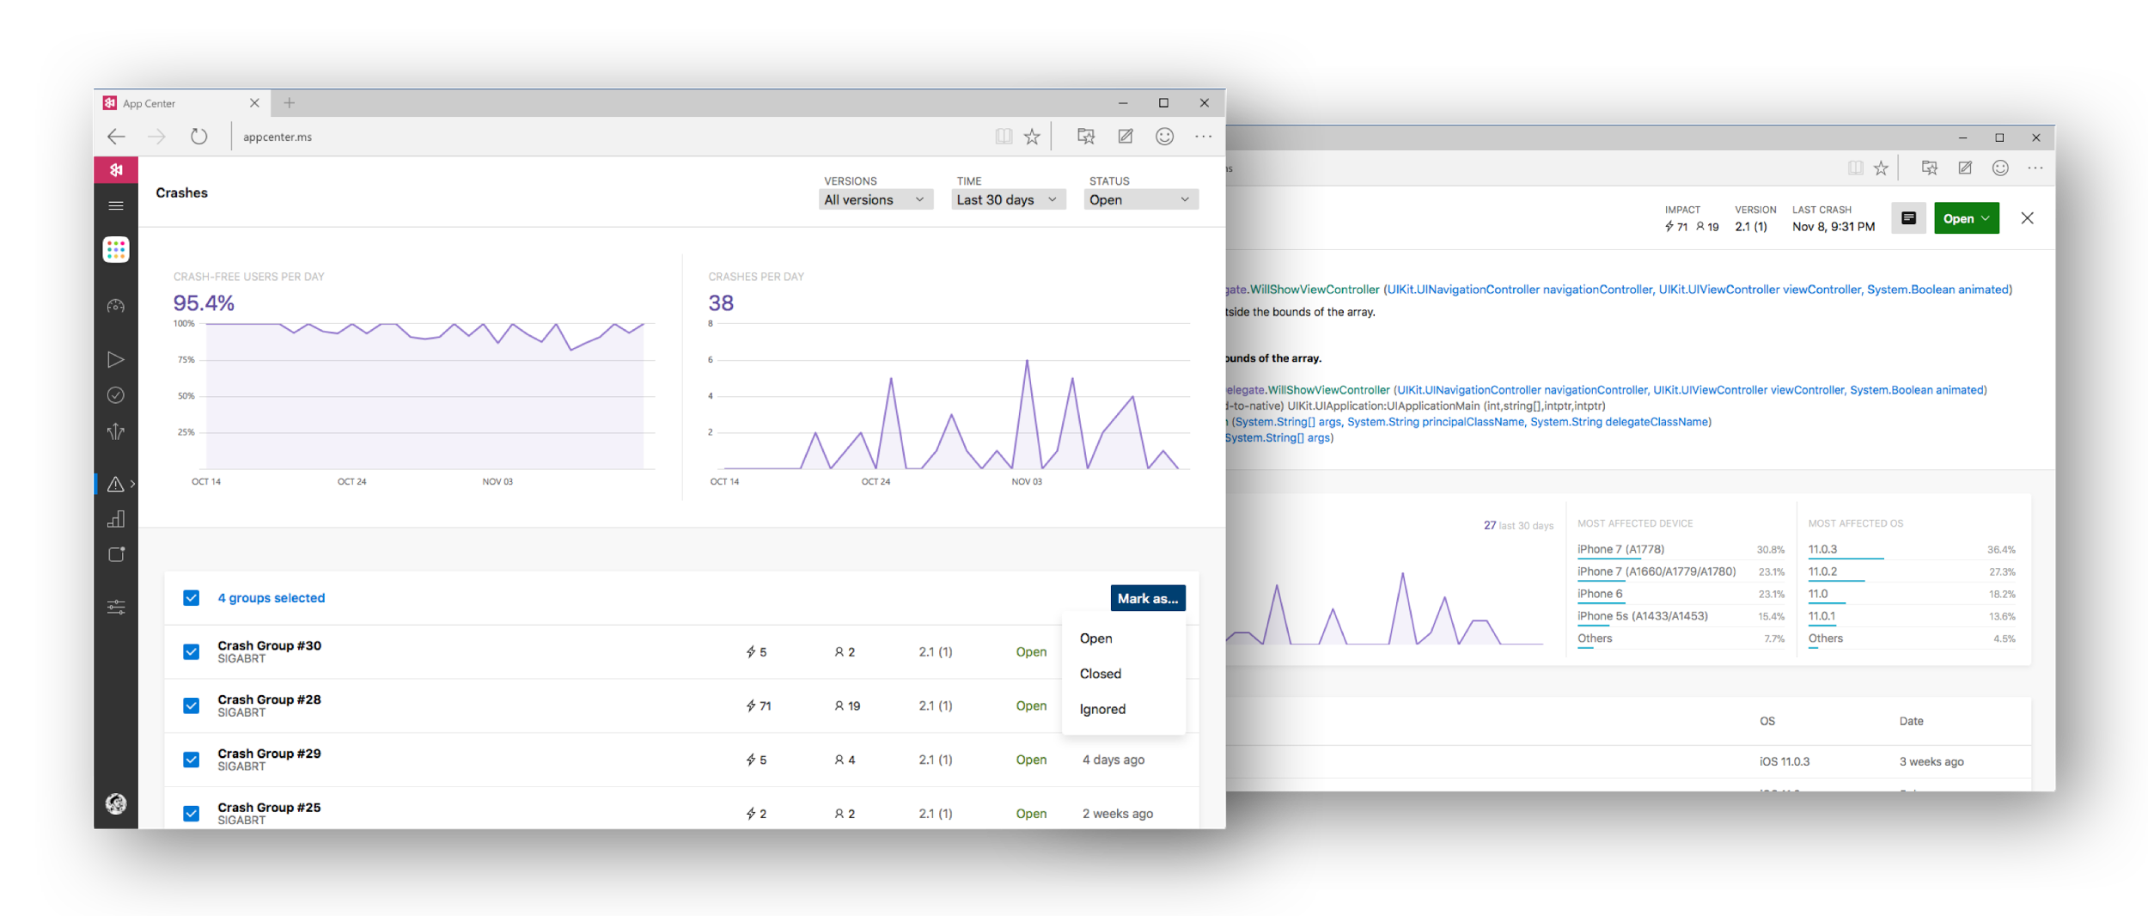

Visual Studio App Center
Notes:
M

Slide 8
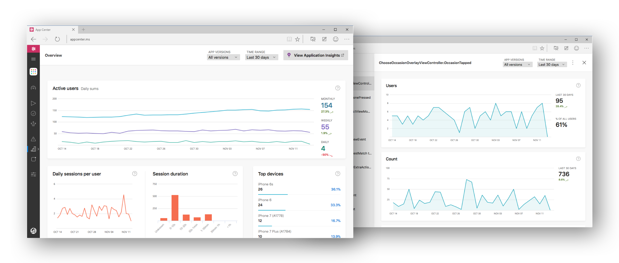
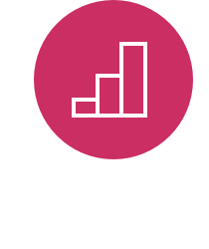
Visual Studio App Center
Notes:
M

Slide 9
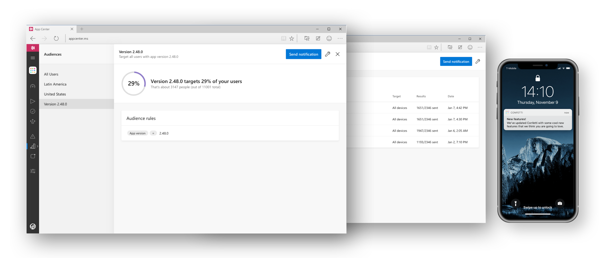

Visual Studio App Center
Notes:
R

Slide 10
Demo – appcenter.ms

Slide 11
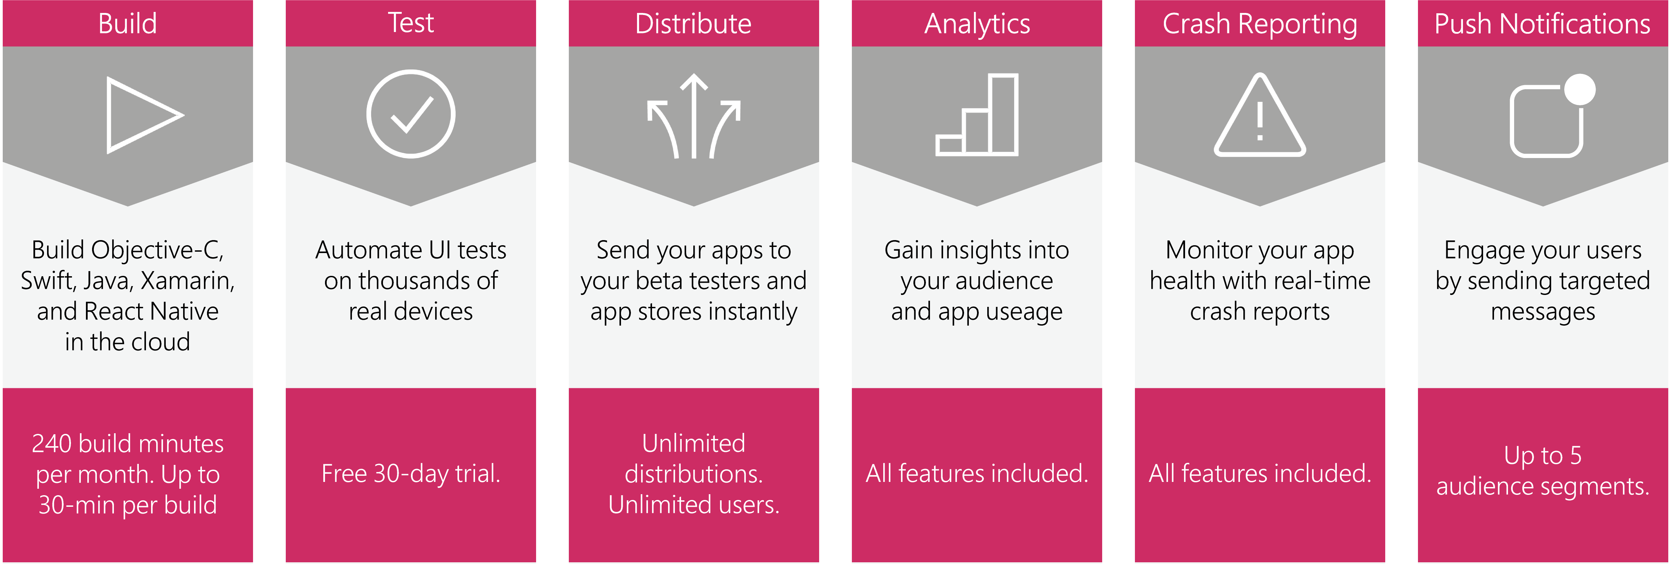
Run unlimited, faster builds
Test your app in the cloud
Target additional audience segments
Ship your app faster with multiple builds running in parallel.
Each paid build comes with unlimited build time, ensuring all builds run and complete.
Run UI tests on thousands of real devices and hundreds of configurations.
Each device concurrency comes with 30 device hours per month, with an upgrade option for unlimited hours.
Engage your audience with targeted messaging at the right time.
Pay per number of monthly active devices for targeting more than 5 audience segments.
+$40/month
per build concurrency
+$99/month
per test device concurrency
+$10/month
per 100k active devices
Notes:
Highlight zero cost of entry, pay-as-you-go, pay-for-only-what you use

Slide 13
Q&A
Domande e risposte

Slide 14
WPC055 – Visual Studio App Center Deep Dive
RICCARDO CAPPELLO
@rcappello
rcappello@outlook.com
Operative manager @alten italia Microsoft Azure MVP Intel Software Innovator

Slide 15

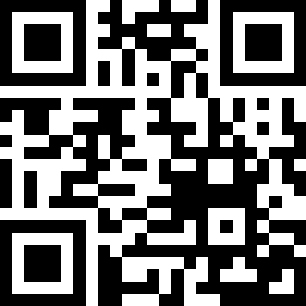

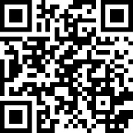


Contatti
OverNet Education
Info@OverNetEducation.it
www.OverNetEducation.it
Rozzano (MI) +39 02 365738
Bologna +39 051 269911
www.wpc-overneteducation.it
ROZZANO (MI) BOLOGNA ROMA GENOVA TORINO NAPOLI

